Slide 1
SUBSTANCE-RELATED & ADDICTIVE DISORDERS

Slide 2
Objectives
By the end of the lesson, the learner should be able to:-
Define substance withdrawal, intoxication
Explain social, economic, and medical effects of substance use
Describe classes of drugs of abuse and their symptoms: intoxication/withdrawal
Describe the diagnostic criteria(DSM 5) of addictive disorders and substance related disorders,
Describe the management of Substance-related & addictive disorders.

Slide 3
The Substance-Related Disorders include disorders related to;
taking of a drug of abuse (including alcohol)
the side effects of a medication
toxin exposure

Slide 4
The substances are grouped into 11 classes;
Alcohol
Sedative, hypnotic, or anxiolytic substances.
Cocaine
Amphetamine and related substances
Hallucinogen
Cannabis sativa
Phencyclidine (PCP) and related substances
Inhalant
Nicotine
Opioid
Caffeine

Slide 5
The Substance-Related Disorders are divided into two groups:
Substance Use Disorders;
Substance Dependence
Substance Abuse
Substance-Induced Disorders;
Substance Intoxication
Substance Withdrawal
Substance-Induced Delirium

Slide 6
Substance-Induced Persisting Dementia
Substance-Induced Persisting Amnesic Disorder
Substance-Induced Psychotic Disorder
Substance-Induced Mood Disorder
Substance-Induced Anxiety Disorder
Substance-Induced Sexual Dysfunction
Substance-Induced Sleep Disorder

Slide 7
Definitions
Drug:
- refers to any chemical agent that once taken in the body is
capable of causing physiological and psychological changes
Psychoactive substance:
a chemical compound that produces emotional, cognitive or
behavioural changes which may be pleasurable or
desirable to the user, with adverse medical consequences
Abuse:
is a pathological pattern of use of substances
one experiences loss of control and begins to suffer health, social and occupational effects

Slide 8
Tolerance:
The need for more of the drug in order to achieve a similar effect
realized before at a lower dose
Dependence:
Refers to compulsion to take the drug on a continuous basis in order
to feel its effects and to further avoid the discomfort of its absence
Substance intoxication:
The development of a reversible substance specific syndrome due to
recent ingestion of or exposure to a substance

Slide 9
Substance withdrawal:
The development of a substance specific syndrome due to the cessation of or reduction in substance use that has been heavy and prolonged.
The substance specific syndrome causes clinically significant distress and
impaired functioning

Slide 10
Impairment and Complications
Deterioration in general health.
Nutrition inadequacy: Malnutrition may result from improper diet
i.e. Malabsorption of vitamins Bs due to alcoholism
General medical conditions e.g. abdominal ulcers, liver cirrhosis
Inadequate personal hygiene.
Trauma: related to impaired motor coordination or faulty judgment.
sudden death: Stimulant use can result in sudden death from:
Cardiac arrhythmias, myocardial infarction,
Cerebrovascular accident, or respiratory arrest.

Slide 11
Infections: The use of contaminated needles during intravenous
administration of substances can cause:
HIV infection, hepatitis, tetanus, vasculitis, septicaemia,
sub acute bacterial endocarditis, embolic phenomena, and malaria.
Violent or aggressive behaviour : may be manifested by:
fights or criminal activity,
can result in injury to the person using the substance or to others

Slide 12
Adverse effects on the developing foetus :
Most of the substances can cross the placenta barrier,
they may have potential adverse effects on the developing foetus
When taken repeatedly in high doses by the mother, a number of substances (e.g., cocaine, opioids, alcohol, sedatives, hypnotics, and anxiolytics) are capable of causing:
physiological dependence in the foetus or
withdrawal syndrome in the newborn.
Foetal alcohol syndrome in the newborn

Slide 13
Substance use disorders
Substance use disorders are a group of mental disorders
manifested by
impairments in social and occupational functions,
which are related to a regular use of specific substances that
are intended to alter mood or behaviour.
Alcohol is one of the commonly used psychoactive substance.
Alcoholism affects 7.5-10 million people worldwide,
mainly those in early and middle adulthood.
Substance abuse is more common in men than in women

Slide 14
Presenting Complaints
Patients may be depressed, or nervous
May exhibit signs of insomnia.
They may directly request a prescription for narcotics or other
drugs,
May request help to stop, or help in stabilising their drug
use.
They may present in a state of intoxication, withdrawal or
physical complications of drug use, for example, abscess or
thrombosis.

Slide 15
They may also present with social or legal consequences of
their drug use, e.g. debt or prosecution.
Occasionally, covert drug use may manifest itself as bizarre,
unexplained behaviour.
Signs of drug withdrawal include:
Opioids lead to nausea, sweating, hallucinations.
Sedatives lead to anxiety, tremors, hallucinations.
Stimulants lead to depression, moodiness.

Slide 16
Substance Use Disorders: DSM 5 Diagnostic Criteria
There are 11 diagnostic criteria
Two (2) or more within a period of 12-months
Must include a pattern of use leading to clinically significant impairment or distress

Slide 17
DSM 5 Diagnostic Criteria
Substance often taken in larger amounts or over a longer period of time than intended
A persistent desire or unsuccessful efforts to cut down or control use
A great deal of time spent in activities necessary to obtain the substance, use it, or recover from its effects
Craving, or strong desire or urge to use
Recurrent use resulting in failure to fulfill major role obligations at work, school, or home

Slide 18
6. Continued use despite having persistent or recurrent
social/interpersonal problems caused or exacerbated by use
7. Important social, occupational, or recreational activities given up or
reduced because of use
8. Recurrent use in situations which is physically hazardous
9. Use is continued despite knowledge of having a persistent or
recurrent physical/psychological problem likely to have been caused
or exacerbated by use

Slide 19
10. Tolerance: the need for markedly increased amounts of substance
to achieve intoxication or desired effect, or a markedly diminished
effect with continued use of same amount
11. Withdrawal: a characteristic syndrome, or use to relieve or avoid
withdrawal

Slide 20
The diagnosis will be aided by:
Taking the patient's personal history (especially drug use).
Examination for needle tracts, complications, e.g. ,
thrombosis or viral illness.
Investigations for haemoglobin, Liver Function Tests (LFTs,urine for drug screen and hepatitis B and C.

Slide 21
Management
If the patient is not willing to stop or change drug use:
Do not reject or blame the patient.
Advise the patient on harm-reduction strategies, e.g. , on the
dangers of needle sharing by intravenous drug users.
Point out clearly the medical, psychological and social problems associated with drug use.
Make a future appointment to reassess health and discuss drug use

Slide 22
If the patient is willing to reduce the drug uses but not to quit
completely:
Negotiate a clear goal for decreased use, e.g. not more than
one marijuana or cigarette per day.
Discuss strategies to avoid or cope with high-risk situations.
Introduce self-monitoring procedures, e.g. a diary of
drug use.
Consider options for counselling and/or rehabilitation

Slide 23
If the patient opts to have a substitute drug:
Negotiate a clear use of the prescribed substitute drug.
Discuss ways of avoiding high risk situations, for example social
situations or stressful events.
Consider withdrawal symptoms and how to avoid or reduce
them.
Provide information and management of methadone toxicity.
Consider options for counseling and/or rehabilitation

Slide 24
For patients willing to stop drug use:
Set a definite day to quit.
Consider withdrawal symptoms and how to manage them.
Discuss strategies of avoiding or coping with high risk
situations.
Make specific plans to avoid drug use, e.g. how to
respond to friends who still use drugs.
Identify family or friends who will support stopping drug use
Consider options for counseling and/or rehabilitation

Slide 25
ALCOHOLISM
Definition
A state of physical and psychological dependency on alcohol.
Its manifested by an individual’s inability to refrain from drinking or to control his consumption of alcohol
World Health Organization definition
A chronic disease or a disorder characterized by excessive alcohol intake and interference in the individual’s health, interpersonal relationship and economic functioning
Considered to be present when there is 0.1% or 10 ml for every 1,000 ml of blood

Slide 26
Alcoholism
Alcoholism is a chronic relapsing disease characterized by four main clinical features:
Tolerance:- a state of adaptation in which more and more alcohol is needed to produce desired effects;
Physical dependence:- The interruption of drinking is characterized by withdrawal syndrome that is relieved by alcohol itself (e.g., morning drinking)
Impaired control:- the alcoholic person cannot regulate total alcohol intake at any drinking occasion once drinking has begun;
Dysphoria of abstinence, or ‘‘craving,’’:- the most elusive feature of alcoholism, which leads to relapse.

Slide 27
Dynamics of Alcoholism
Social drinking may progress to abuse
The reliance on excessive drinking as a means of dealing with personal tension and discomfort
This clearly suggests that psychological factors play a key role in the development of alcohol abuse.
Alcohol being a depressant aids in the relaxing of the individual and releases inhibitions
Following a drinking episode, the alcohol abuser is often overwhelmed with feelings of remorse and guilt

Slide 28
Phases of Progression of Alcoholism
1) Pre-alcoholic Phase
Starts with social drinking until tolerance begins to develop
Relying on alcohol to unwind or relax
Needing a drink to engage in social situations
Using alcohol to cope with uncomfortable feelings or emotions
2) Prodromal Phase
Alcohol becomes a need; blackouts occur; denial begins to develop
Regular binge drinking
“Blacking out” (memory loss caused by drinking)
Difficulties controlling the amount of drink
Attempting to cut down or stop drinking but difficult to do so.

Slide 29
3) Crucial Phase
Cardinal symptoms of alcoholism develops (loss of control over drinking increases)
regularly hungover and craving for more alcohol.
Tolerance becomes evident
Body Changes i.e. facial redness, stomach bloating, shaking, sweating and memory lapses.
4) Chronic Phase
The person becomes intoxicated all day
Paranoia is frequently seen during this phase
Liver damage may occur

Slide 30
Etiological Theories of Alcoholism
1) Psychoanalytic Theories
Due to fixation in the oral stage of development
2) Learning Theories
Due to a learned behavior
3) Biological Theories
Due to inherited traits
4) Socio-cultural Theories
Due to effects of mass media

Slide 31
Manifestations of Different Blood Levels of Alcohol
 | BLOOD LEVEL | MANIFESTATION
1. | 0.1% TO 0.2% | Low coordination
2. | 0.2% TO 0.3% | Presence of ataxia, tremors, irritability, stupor
3. | 0.3% and above | Unconsciousness

Slide 32
Effects of Alcohol
A sedative anesthetic,
Alcohol is absorbed in the small intestine;
Approximately 95% is broken down by the liver,
The rest is excreted through the lungs, the kidneys and skin.
Generally, a person can metabolize 10 ml of alcohol or 1 ounce of whiskey every 90 minutes
2. Death:
If taken in exceedingly high doses, it can depress respiration and cause death.

Slide 33
3. Intoxication:
Intoxication occurs when a person’s blood alcohol level is 0.1% or more.
Simple intoxication lasts less than 12 hours and is usually followed by a hangover
4. Hangover has unpleasant symptoms i.e.
Nausea, vomiting, gastritis, headache, fatigue, sweating, thirst, vasomotor instability
Occurring approximately 4 - 6 hours after alcohol ingestion.
Hangover is attributed metabolic disorders

Slide 34
5. Metabolic disorders:
The cause of hangover is uncertain
The symptoms are attributed to hypoglycemia and the accumulation of lactic acid and acetaldehyde in the blood.
6. Alcoholic hallucinosis
Auditory hallucinations reported approximately 48 hours after heavy drinking

Slide 35
Alcohol-Related Disorders
Prevalence – 12% of males and 4.6% of females 18 and older.
Significantly drops after age 65.
Can lead to persisting neurocognitive disorders
Alcohol Intoxication includes 1 or more symptoms of:
slurred speech,
incoordination,
unsteady gait,
nystagmus (involuntary eye movement),
attention impairment
memory impairment,
stupor/coma

Slide 36
Alcohol-Related Disorders
Alcohol Abuse
Alcohol misuse is a common substance abuse problem.
Patients may present with:
Depressed mood.
Nervousness.
Insomnia.
Physical complications of alcohol use, e.g.,
- gastrointestinal ulceration,
- gastritis, liver disease, and hypertension.

Slide 37
Accidents or injuries due to alcohol use.
Poor memory or concentration.
Evidence of self-neglect.
Poor compliance to management for depression.
The patient may also have experienced legal and social problems
due to alcohol use, e.g. ,
marital problems, domestic violence, child abuse and
neglect or missed work.

Slide 38
The individual may show signs of alcohol withdrawal, which include:
sweating, tremors, morning sickness,
hallucinations and seizures.
Patients may sometimes deny or are unaware of alcohol problems.
Family members may request help before the patient does.
The problem may also be identified during a routine health promotion
screening.

Slide 39
Alcohol Withdrawal
Alcohol Withdrawal includes two (2) or more of following after cessation of or reduction in alcohol use:
Autonomic hyperactivity (sweating or pulse > 100)
Increased hand tremor
Insomnia
Nausea or vomiting
Transient visual, tactile, auditory hallucinations
Psychomotor agitation
Anxiety
Seizures

Slide 40
Stages of Alcohol Withdrawal Syndrome
1) Tremulousness
Occurs during the drinking period up to 2 hours afterward.
There is anxiety, agitation and irritability
As it progresses, tremors, tachycardia and diaphoresis are exhibited
2) Hallucinations
Begins 12 – 48 hours after the person stops drinking
Gastrointestinal symptoms of nausea, vomiting, diarrhea and anorexia are present

Slide 41
3. Delirium tremens
A condition of severe memory disturbance, agitation, anorexia and hallucinations
Begins a few days after drinking stops and ends within
1 – 5 days
There is elevated temperature, severe diaphoresis, hypertension and tachycardia
Behavioral symptoms include confusion with disorientation, agitation, tremors, and alterations in sensory perception.

Slide 42
Delirium Tremens
State of withdrawal usually 3-4 days after total cessation manifested by delirium and confusion
Clinical features include:
Insomnia, anxiety, fear, restlessness
tremors and convulsions
Clouding of consciousness, disorientation, and confusion
Visual and auditory hallucinations with illusions
Over-activity of the autonomic NS
Delusions, agitation and sleep disturbances

Slide 43
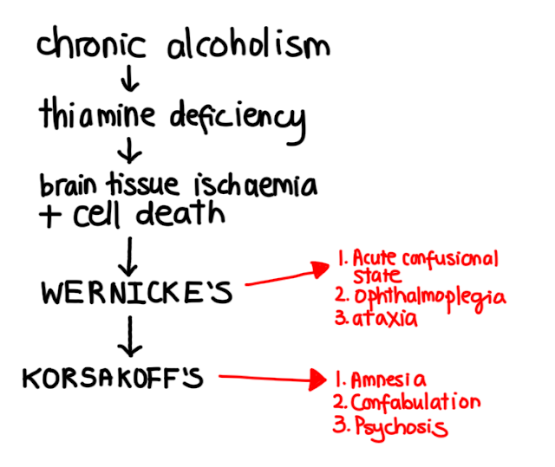
Nutritional Deficiencies (Thiamine / Vit B1),
Leads to Wernicke,s encephalopathy, Korsakoff’s psychosis and alcoholic dementia.

Slide 44
Wernicke encephalopathy
Symptoms include:
Confusion
Reduced mental activity that may progress to coma or death
Ataxia, or loss of muscle coordination causing leg tremors
Double vision, drooping eyelid, abnormal eye movements, or other vision changes
Alcohol withdrawal symptoms
Muscle atrophy or weakness
Diminished reflexes and balance

Slide 45
Korsakoff psychosis
Symptoms include:
Severe memory loss
Inability to form new memories
Confusion or making up stories
Lack of coordination
Personality changes
Visual and auditory hallucinations
Being easily frustrated

Slide 46
Clinical features of Alcohol Withdrawal
SYNDROME | CAUSE | ONSET | ESSENTIAL FEATURE | OTHER SIGNS AND SYMPTOMS
DELIRIUM TREMENS | Faulty metabolism of alcohol | Acute | Delirium | Increased vital signs Visual and tactile hallucinations Coarse tremors
KORSAKOFF’S PSYCHOSIS | Thiamine and Niacin deficiency | Chronic | Memory Disturbances | Retrograde amnesia Anterograde amnesia Confabulation
WERNICKES PSYCHOSIS | Thiamine deficiency | Chronic |  | Confusion Opthalmoplegia Ataxia

Slide 47
Diagnostic Features of Alcohol Abuse
Harmful alcohol use refers to the consumption of over 28 units per week for men and over 21 units per week for women.
This can result in:
Physical harm, e.g. ,
liver disease, gastrointestinal bleeding,
Psychological harm, e.g. ,
depression or anxiety or
Social consequences, like the loss of a job.

Slide 48
Alcohol dependence is said to be present when any of the
following factors are present:
Strong desire or compulsion to use alcohol.
Difficulty controlling alcohol use.
Withdrawal symptoms, for example, anxiety, tremors, sweating, when drinking is ceased.

Slide 49
Diagnosis for alcohol use problems
CAGE: 1. Cut Down 2. Annoyed 3. Guilty 4. Eye Opener
This is a simple and effective screening tool that involves asking the following four (4) questions
Has the patient ever tried to Cut Down on their drinking?
Do they get Annoyed when people talk about their drinking?
Do they ever feel Guilty about their drinking?
Do they ever take an Eye Opener (EARLY MORNING) drink?
A positive answer is 2 or more “YES” responses

Slide 50
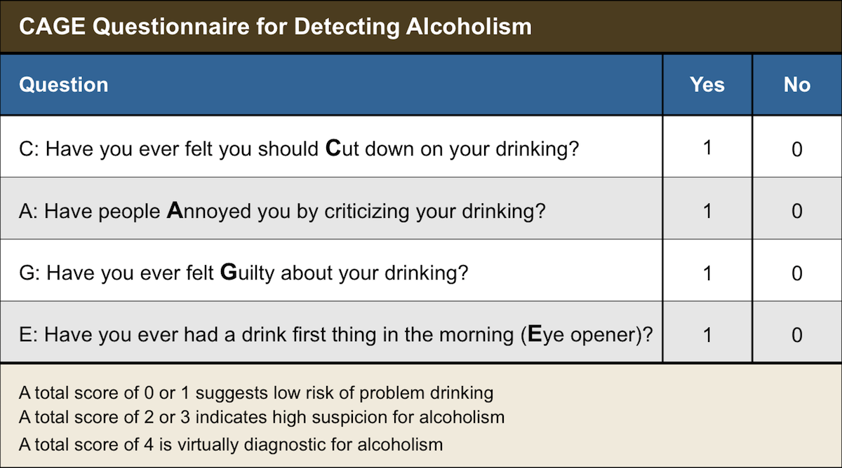
Alcoholism screening questions known as CAGE

Slide 51
Management of Alcohol Intoxication
Dextrose 10- 50% can be administered to promote brain metabolism and prevent hypoglycemic crisis.
Intubation
In severe cases - those of severe stupor and coma –
the person should be intubated to support respirations and to protect
the lungs from filling with vomit/secretions.

Slide 52
Other management Strategies
Ensure safety
Psychotherapy
Rehabilitation
Refer to support group e.g. alcohol anonymous
Antidote of alcohol- Disulfiram.
Pharmacology e.g. Antipsychotic agents

Slide 53
Other screening tools include:
Short Michigan alcohol screening test (S-MAST)
Laboratory investigations such as blood alcohol concentration (BAC), breath alcohol levels etc.

Slide 54
Pharmacologic Treatment of Alcoholic Patients
IV fluids for dehydration
B-Complex vitamins precaution or treatment for vitamin deficiency.
Vitamin B1 (Thiamine) is often prescribed to prevent or to treat Wernicke’s syndrome and Korsakoff’s syndrome
Vitamin B12 (Cyanocobalamin) and folic acid are often prescribed for clients with nutritional deficiencies
Thiamine (150mg per day in divided doses) should be given orally for
one month.
Parenteral thiamine is indicated for patients with ataxia, confusion,
memory disturbances, delirium tremens, hypothermia and
hypotension, ophthalmoplegia or unconsciousness

Slide 55
Benzodiazepine (anxiolytic) agent: Used for Alcohol withdrawal to suppress the symptoms of abstinence.
The most commonly used benzodiazepines are lorazepam, chlordiazepoxide and diazepam.
In such cases, chlordiazepoxide (librium) at 10mg is
recommended.
The initial dose should be considered against withdrawal
symptoms within a range of 5-40mg four times a day.
This requires close and skilled supervision.

Slide 56
The regimen the dose level and length of treatment will depend on
the severity of alcohol dependence and individual patient factors,
e.g. , weight, sex and liver function.
Treatment should be dispensed daily.
Involve a family member to prevent the risk of misuse or overdose.

Slide 57
Daily Treatment - Diazepam
Day 1 and 2 | 20-30mg | QDS
Day 3 and 4 | 15mg | QDS
Day 5 | 10mg | QDS
Day 6 | 10mg | QDS
Day 7 | 10mg | QDS

Slide 58
Dextrose 10- 50% can be administered to promote brain metabolism and prevent hypoglycemic crisis.
Disulfiram (Antabuse) may be prescribed to help deter clients from drinking.
If a client taking disulfiram drinks alcohol, a severe adverse reaction occurs i.e.
- flushing, a throbbing headache, sweating, nausea and vomiting.
In severe cases, severe hypotension, confusion, coma, and even death may result

Slide 59
The client must avoid products that contain alcohol such as:
Cough syrup, lotions, mouthwash, perfume, aftershave, vinegar and vanilla and other extracts.
The client must read product labels carefully because any product containing alcohol can produce the symptoms.

Slide 60
General treatment for Alcohol Abuse
For patients with mild withdrawal symptoms, frequent monitoring,
support, reassurance, adequate hydration and nutrition are sufficient
treatment without medication.
Patients with moderate withdrawal syndrome will also require
benzodiazepines.
Most can be detoxified as outpatients or at home.
Only practitioners with appropriate training and supervision should
do community detoxification

Slide 61
Inpatient detoxification is indicated for:
Patients at risk of complicated withdrawal syndrome, e.g., with a history of fits or delirium, tremors, very heavy use
and high tolerance.
Significant polydrug use or severe morbid medical or
psychiatric disorder
Lack social support or are considered to have a significant suicide risk.

Slide 62
When depression concurs with alcohol misuse,
Selective Serotonin Re-uptake Inhibitors (SSRI) may be used
Tricyclic antidepressants should be avoided because of
tricyclic-alcohol interactions.
For anxiety, benzodiazepines should be avoided because of
high potential for abuse

Slide 63
Drugs used for Alcoholic Patients
DRUG | USE | DOSAGE | NURSING CONSIDERATIONS
Lorazepam (Ativan) | Alcohol withdrawal | 2 – 4 mg every 2 – 4 hours prn | Monitor vital signs and global assessments for effectiveness; may cause dizziness and drowsiness
Chlordiazepoxide (Librium) | Alcohol withdrawal | 50-100 mg, repeat in 2-4 hours if necessary, not to exceed 300 mg/day | Monitor vital signs and global assessments for effectiveness; may cause dizziness and drowsiness
Disulfiram (Antabuse) | Maintain abstinence from alcohol | 500 mg/day for 1-2 weeks, then 250 mg/day | Teach client to read labels to avoid products with alcohol
Thiamine (Vitamin B1) | Prevent or treat Wernicke, Korsakoff syndrome | 100 mg/day | Teach client about proper nutrition
Folic Acid (folate) | Treat nutritional deficiencies | 1 – 2 mg/day | Teach client about proper nutrition; Urine may be dark yellow
Cyanocobalamin (Vitamin B12) | For nutritional deficiencies | 25 – 250 mcg/day | Teach client about nutrition

Slide 64
Mgt of substance related disorders in general
Goals:
Maximizing patients' motivation for abstinence –
These include lectures, counselling sessions, the use of self-help
groups, and videotapes
to educate the individual and his family about the dangers involved with substance use
the usual clinical course of substance use disorders,
Emphasize that each person is responsible for his or her own
actions

Slide 65
2. Teaching patients how to rebuild their lives after redirecting the focus of their activities away from the use of substances –
Important elements in developing a substance-free lifestyle
helping the person to discover ways of dealing with free time;
to develop friendships & independent of the context of drug use

